Slide 1
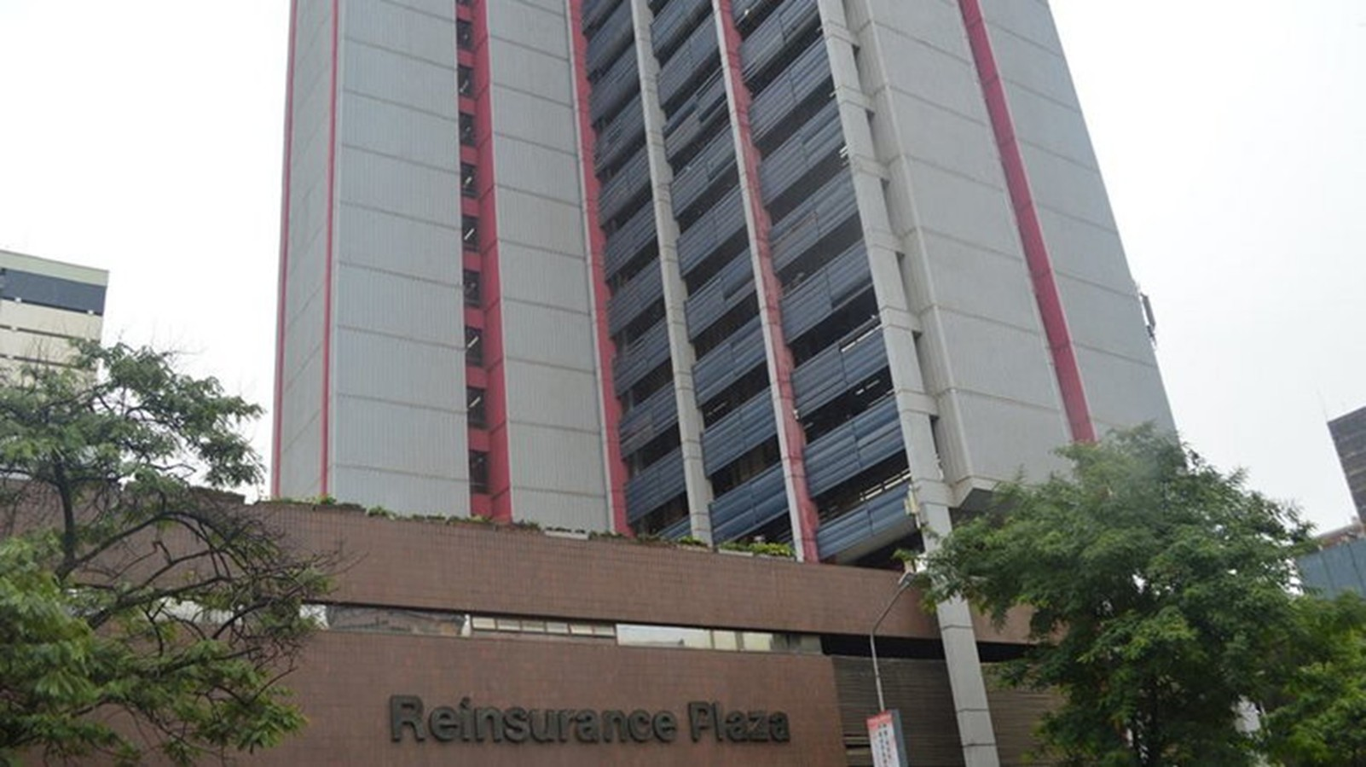
TrueClaim AI
Presented By
The Hacknovators
1
PROBLEM
Claims Processing and Fraud Detection Using AI
Current State | Desired State
Too much reliance on manual data entry and verification. Slow processing times. Fraudulent claims often slip through undetected. Frustrated Stakeholders | Automated document processing. Faster claim settlement. Free staff for higher value tasks Enhanced customer experience with quicker solutions.

Slide 2

PROBLEM
Claims Processing and Fraud Detection Using AI
Current State | Desired State
Too much reliance on manual data entry and verification. Slow processing times. Fraudulent claims often slip through undetected. Frustrated Stakeholders | Automated document processing. Faster claim settlement. Free staff for higher value tasks Enhanced customer experience with quicker solutions.
2
STAKEHOLDERS
People or organizations that can be affected or can benefit from this system.
Insurers
Reinsurers
Insured
Regulators
Staff and Rating Agencies

Slide 3

STAKEHOLDERS
People or organizations that can be affected or can benefit from this system.
Insurers
Reinsurers
Insured
Staff
3
DATA SOURCES
Treaty Slips
OCR Bordereau
Claims Notifications
Cash Call Reports
SICS Treaty Details

Slide 4
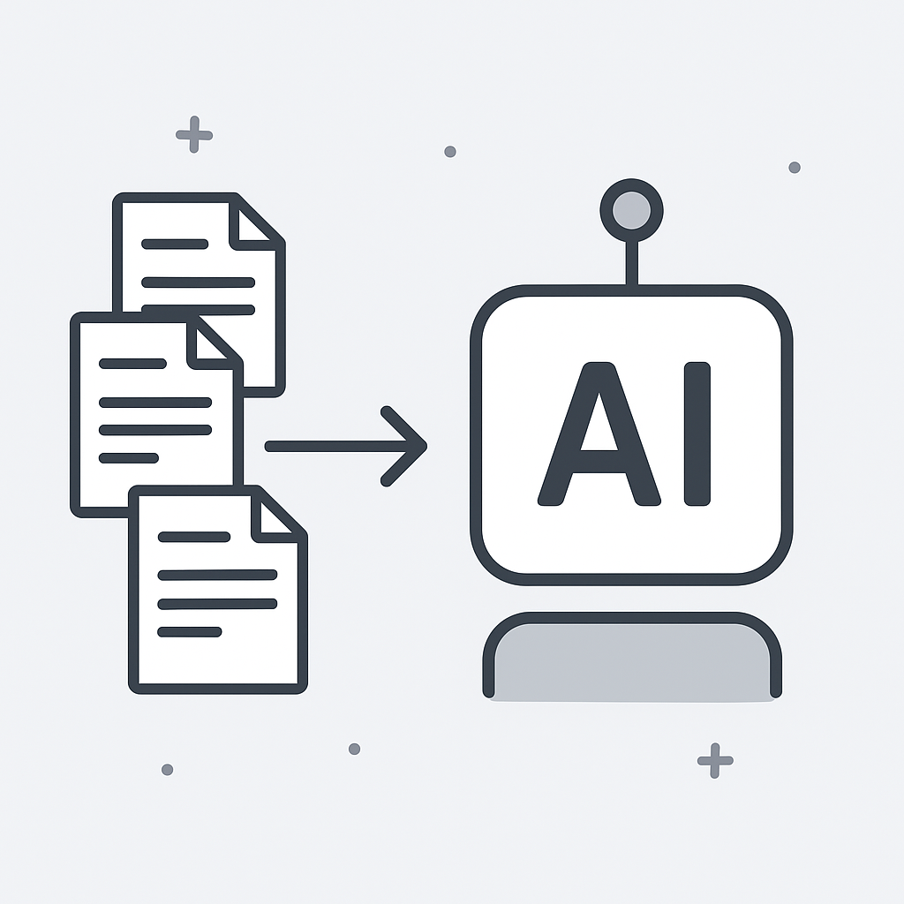
DATA SOURCES
Treaty Slips
OCR Bordereau
Claims Notifications
Cash Call Reports
SICS Treaty Details
4
WORKFLOW
In this slide, the whole process the AI will go through is explained with aid of a flow chart included in the GitHub Repository.

Slide 5
WORKFLOW
In this slide, the whole process the AI will go through is explained with aid of a flow chart included in the GitHub Repository.
5
WHAT ARE SOME OF THE BENEFITS?
Real-time settlements
Lower loss ratios
Better Customer Service
Resource Optimization

Slide 6

WHAT ARE SOME OF THE BENEFITS?
Real-time settlements
Lower loss ratios
Better Customer Service
Resource Optimization
6
TOOLS USED
Mermaid Live Server and Editor for coding and drawing the workflow.
Chat GPT & Cloud AI for more insight on various terms used in Reinsurance.
Microsoft Visual Code as the IDE for Python.
Lang Chain for developing an AI agent.

Slide 7

TOOLS USED
Mermaid Live Server and Editor for coding and drawing the workflow.
Chat GPT & Cloud AI for more insight on various terms used in Reinsurance.
Microsoft Visual Code as the IDE for Python.
Lang Chain for developing an AI agent.
7
CONCLUSION
It has been an honor to be here, and given this opportunity to participate in this hackathon. We have learnt a lot from each other and it was exciting interacting with people in the field.
We are grateful to Kenya RE and University of Nairobi for organizing the event. It has been a blast!
The Hacknovators.

Slide 8
CONCLUSION
It has been an honor to be here, and given this opportunity to participate in this hackathon. We have learnt a lot from each other and it was exciting interacting with people in the field.
We are grateful to Kenya RE and University of Nairobi for organizing the event. It has been a blast!
The Hacknovators.

